Slide 1

Smart Patient Health Monitoring System
Presented by:
Sanskar Patil (B-840)
Samarth Sawant (B-836)
Rishikesh Patil (B-837)
Under the supervision of:
Prof. Kavita Rathi

Slide 2
Introduction to Smart ICU System
IoT-based Patient Monitoring System: The Smart ICU system leverages Internet of Things (IoT) technology to monitor patients continuously, enhancing the quality of care and ensuring timely interventions.
Real-Time Health Tracking: This system provides real-time tracking of patient vitals, allowing healthcare professionals to respond quickly to any changes in a patient's condition.
Automation of ICU Monitoring: By automating the monitoring process, the Smart ICU system significantly reduces the dependency on manual observation, enabling staff to focus on direct patient care.
Vital Data Collection through Sensors: Advanced sensors collect and transmit vital signs such as heart rate, blood pressure, and oxygen levels, ensuring that healthcare teams have access to the most current data.
Remote Monitoring Capability: The system facilitates remote monitoring, allowing healthcare providers to oversee multiple patients from a centralized location, improving efficiency and response times.
Instant Alerts for Abnormal Values: In case of abnormal values detected by the sensors, the system instantly alerts medical staff, ensuring immediate attention and care for patients in critical conditions.

Slide 3
Literature Survey
no | Year | Authors | Main Principle | Outcome
1 | 2017 | Al Alkeem et al | Introduced a new secure healthcare system utilizing the Cloud of Things (CoT). | We understood the integration of cloud computing and IoT technologies to ensure secure and efficient health data management
2 | 2014 | Kim et al | Investigated the coexistence of ZigBee-based Wireless Body Area Networks (WBANs) and WiFi for health telemonitoring systems. | Realized the addressing interference issues and optimizing network performance to facilitate reliable health data transmission
3 | 2013 | Baig and Gholamhosseini | Provided an overview of smart health monitoring systems, emphasizing design principles and modeling techniques. | Their study outlined various components and functionalities of these systems, highlighting their potential in improving healthcare outcomes
4 | 2015 | Riazulislam et al. | Conducted a comprehensive survey on the Internet of Things (IoT) for healthcare. | We studied various IoT applications, including remote patient monitoring, wearable devices, and healthcare analytics, underscoring the transformative impact of IoT in the healthcare domain

Slide 4
Problem Statement
Inefficiencies and Risks in Manual Monitoring: Traditional ICUs rely heavily on manual monitoring, leading to delays in detecting critical patient conditions, increased risk of human error, and potential fatalities due to missed or delayed responses.
Overburdened Healthcare Staff and Lack of Remote Access: Healthcare professionals face overwhelming workloads, limiting their ability to monitor multiple patients effectively, while the absence of remote monitoring hinders timely interventions, further jeopardizing patient safety.

Slide 5
Objectives
Real-time Monitoring : Implement continuous tracking of vital parameters such as Heart Rate (HR), Blood Oxygen Saturation (SpO2), and Temperature to ensure immediate response capabilities.
Automated Alerts : Establish a notification system that automatically informs medical staff when vital parameters exceed predefined thresholds, ensuring rapid intervention.
Remote Access : Enable cloud-based access for doctors, allowing healthcare professionals to monitor patients from anywhere, facilitating timely decisions and interventions.
Predictive Analytics : Leverage AI-driven analysis to identify potential health risks early, enhancing proactive healthcare management and improving patient outcomes.
Secure Data Management : Implement robust data management practices to ensure compliance with healthcare regulations, safeguarding patient information and ensuring privacy.

Slide 6
Flowchart of System Architecture
Data collection from sensors
Data processing by Arduino mega 2560
Wireless Data Transmission via WiFi
Cloud Database Storage
Alert mechanism via SMS and Email
Frontend Data Display
Backend data processing and analysis
.

Slide 7
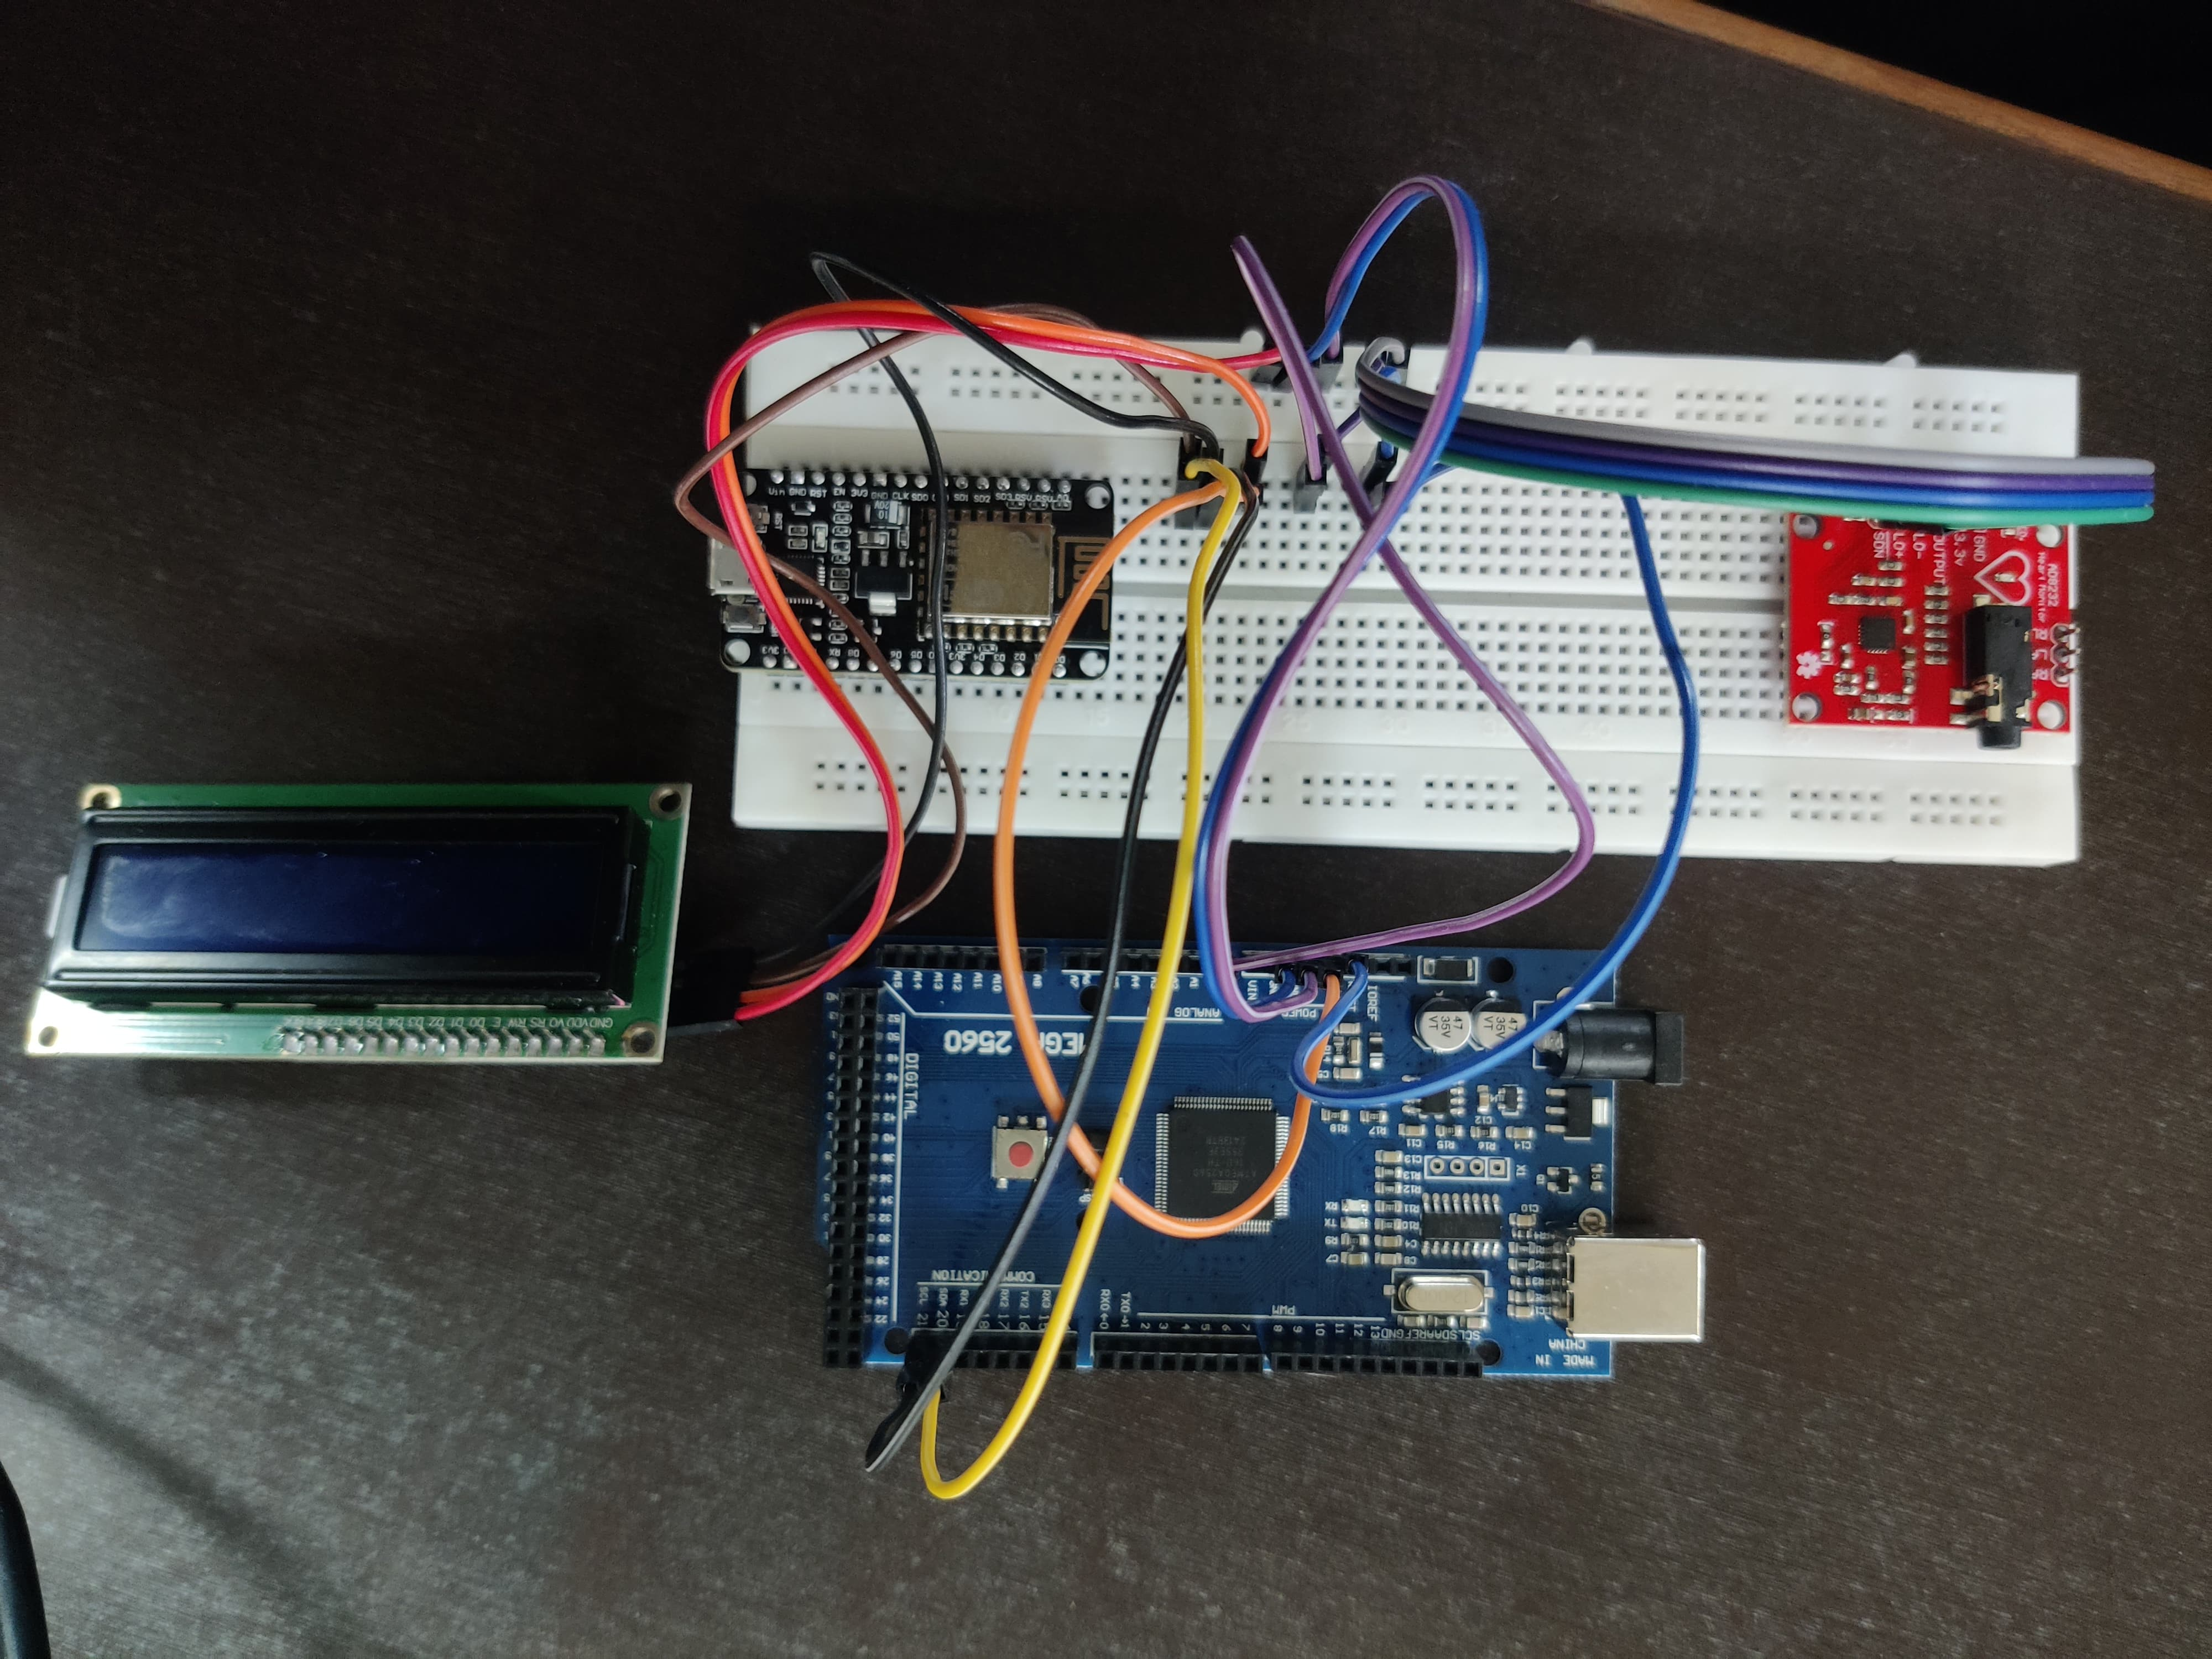
Hardware Setup

Slide 8
ARDUINO MEGA 2560
Methodology
Arduino Mega 2560: Acts as the central processing unit in the system. It simulates various sensors like heart rate, body temperature, and other health metrics. It communicates with the sensors (real or simulated), collects data, and transmits it for processing or visualization.
The Arduino Mega 2560 offers several advantages over the Arduino Uno, making it a better choice for our project. Here are some advantages Arduino Mega holds over Arduino UNO:
More I/O Pins: The Arduino Mega 2560 has 54 digital input/output pins (compared to the Uno’s 14), and 16 analog inputs (compared to the Uno’s 6). This is beneficial if your project involves many sensors, actuators, or other peripherals that require multiple connections.
Higher Memory (RAM and Flash): The Mega 2560 has 8 KB of SRAM and 256 KB of flash memory (compared to the Uno’s 2 KB of SRAM and 32 KB of flash). This allows the Mega to handle more complex code, larger programs, and better data processing, making it suitable for more advanced applications.
More Serial Communication Ports: The Mega 2560 has 4 hardware UARTs (serial ports), which means you can connect and communicate with multiple devices (such as GPS modules, Bluetooth modules, or other serial devices) simultaneously without relying on software-based serial communication.
More Processing Power: The Mega 2560 runs at 16 MHz, just like the Uno, but the extra memory and more I/O pins make it more efficient for handling larger tasks, multitasking, or running more complex algorithms.
More External Peripherals: With the increased number of pins and I/O capabilities, you can connect more external peripherals directly to the board without the need for extra multiplexers or shields, which simplifies circuit design and wiring.

Slide 9
16x2 LCD:
This display is used to show critical health information to the healthcare provider or patient on-site, such as heart rate, body temperature, and patient status. In the simulation, this is simulated using the frontend, as the LCD is replaced by dynamic displays (e.g., React UI).
Here are the reasons for using a 16x2 LCD in our project and its advantages:
Simple Text Display: The 16x2 LCD can display 16 characters per line and has two lines, which is ideal for displaying simple, easy-to-read text such as sensor values, system status, or menu options. It’s a straightforward way to show feedback or information to the user.
Low Power Consumption:Compared to more complex displays like TFT or OLED, the 16x2 LCD uses significantly less power, making it well-suited for battery-powered or energy-efficient applications. This ensures longer operating times without needing to recharge or replace batteries frequently.
Cost-Effective:The 16x2 LCD is inexpensive and widely available, making it an affordable solution for many projects where you need to display basic text information. Its affordability makes it an ideal choice for budget-conscious projects or prototypes.
Ease of Integration:The 16x2 LCD is very easy to interface with microcontrollers (like Arduino or Raspberry Pi) via common communication protocols (such as I2C or parallel). Many libraries (like the LiquidCrystal library for Arduino) make it simple to control the display and manage text output.
Backlight Feature:Many 16x2 LCD modules come with a built-in backlight, making it easier to read the display in low-light environments. This feature enhances visibility and user experience, especially in indoor or dimly lit settings.

Slide 10
ECG Sensor (AD8232)
Our ECG sensor monitors the electrical activity of the heart by measuring the ECG signal. In the simulation, the ECG values are generated to represent the patient’s heart rhythm and condition.
Following are the reasons for using AD8232 ECG sensor in our project:
Compact and Easy to Use: The AD8232 is small and easy to integrate into embedded systems, making it well-suited for projects requiring ECG monitoring. It comes in a compact package, which is ideal for wearable applications, portable health monitoring devices, and other compact devices.
High-Quality Signal Processing: The sensor provides high-quality signal amplification and filtering, removing noise and interference from the raw ECG signal. This is critical for accurate heart rate detection and for monitoring the electrical activity in detail.
Real-Time Monitoring: The sensor allows real-time monitoring of ECG signals, which is essential for detecting abnormal heart patterns (like arrhythmias) and providing timely feedback to healthcare professionals or users.
Support for Customizable Applications: Because the AD8232 is often used with platforms like Arduino, it allows developers to create custom applications, whether it's a heart rate monitor, diagnostic tool, or part of a more comprehensive healthcare system.

Slide 11
Web Application
The React application provides a user-friendly interface to display the patient’s health data and live location. It consists of several pages, such as:
Patient Location: Displays the current GPS location of the patient on a map using real-time latitude and longitude coordinates.
Medical History: Tracks historical medical data of the patient, including past health records, vitals, and sensor data
Alerts: Shows any critical health alerts (e.g., abnormal vitals) triggered when sensor data exceeds certain thresholds. For example, an abnormal heart rate or SpO2 level will trigger an alert.
– Health Monitoring: Real-time health parameters like temperature, heart rate, ECG, and SpO2 are displayed and updated periodically. This allows healthcare providers to continuously monitor the patient’s vital signs.

Slide 12
Future Scope
Advanced Alert System with AI Integration: The current alert system is based on threshold values for different health parameters. Future enhancements can incorporate Artificial Intelligence (AI) and Machine Learning (ML) to :
Detect patterns in a patient’s health data over time.
Predict potential health risks based on historical trends
Reduce false alarms by distinguishing between critical conditions and temporary fluctuations.
Cloud-Based Data Storage and Remote Access: At present, patient data is managed on the frontend. A cloud-based infrastructure can be implemented to:
Store real-time patient data securely on cloud servers.
Enable healthcare providers to access patient history from any location.
Allow for data analysis and trend visualization over extended periods.
Mobile App Integration : To improve accessibility, a mobile application can be developed alongside the web interface. This would allow:
Patients and caregivers to receive real-time alerts and notifications.
Doctors to monitor patient vitals remotely from their smartphones.
Location tracking via GPS to be more seamless and efficient.

Slide 13
Challenges and solutions
Challenge: API Integration with Google Maps : Integrating the application with Google Maps API posed significant challenges in terms of functionality and performance. Ensuring seamless communication between our application and Google Maps was crucial for user experience.
Solution: React-Google-Maps API : To address the integration challenges, we utilized the React-Google-Maps API, which allowed for dynamic updates and enhanced interaction with map features. This solution significantly improved the responsiveness of map-related functionalities.
Challenge: Simulating Real-time Sensor Data : Simulating real-time sensor data for testing purposes was another critical challenge. Accurate data representation was necessary to evaluate the system's performance under different scenarios.
Solution: JavaScript Randomization for Test Cases : To effectively simulate real-time sensor data, we implemented JavaScript randomization techniques. This approach allowed us to create varied test cases, ensuring robust testing of the application’s functionality.
Challenge: Ensuring Real-time NotificationsReal-time notifications were essential for user engagement and timely updates. However, maintaining the reliability of these notifications under fluctuating conditions proved to be challenging.
Solution: Backend Alert Triggers via Threshold Limits : To ensure timely notifications, we established backend alert triggers that activated based on predefined threshold limits. This solution allowed for immediate alerting when critical conditions were met, enhancing user response times.

Slide 14
Challenge: LCD Sensitivity and Visibility Issues
The LCD sensitivity was too high, causing excessive brightness. This made it difficult to visualize data presented on the screen.
Solution: Adjusting LCD Contrast and Brightness To counteract the brightness issue, we adjusted the LCD contrast settings and incorporated a resistor to fine-tune the display brightness, improving data visibility.
Challenge: Excessive Noise in ECG Sensor Data
The ECG sensor data was highly noisy, affecting the accuracy of the readings.
Solution: Noise Reduction Using a Resistor To minimize noise, we added a resistor between the Arduino’s analog input and the ECG sensor output. While initially a temporary fix, additional filtering components were introduced to completely eliminate noise.
Challenge: ECG Sensor Stability Issues
The ECG sensor was unstable, leading to inconsistent data and fluctuations in readings.
Solution: Soldering and Secure Mounting To improve stability, we soldered the ECG sensor connections properly and mounted it securely on a breadboard, ensuring reliable and consistent data collection.

Slide 15
Conclusion
Enhanced Patient Monitoring and Real-Time Alerts: The Smart ICU system leverages IoT technology to provide continuous monitoring of vital signs, sending real-time alerts for any anomalies. This enables healthcare professionals to respond quickly, even remotely, improving patient care and safety.
Reduced Workload and Optimized System Efficiency: By automating routine monitoring tasks, the system alleviates the administrative burden on healthcare staff, allowing them to focus on direct patient care. Efficient database management further reduces server load, optimizing system performance.

Slide 16
References
E. Al Alkeem et al., ”New secure healthcare system using cloud of things,” Springer Science+Business Media New York, 2017. Available at: https://www.researchgate.net/publication/316749947_New_ secure_healthcare_system_using_cloud_of_things
. Y. Kim, S. Lee, and S. Lee, ”Coexistence of ZigBee-based WBAN and WiFi for Health Telemonitoring Systems,” IEEE Journal of Biomedical and Health Informatics, DOI: 10.1109/JBHI.2014.2387867.
M. M. Baig and H. Gholamhosseini, ”Smart Health Monitoring Systems: An Overview of Design and Modelling,” Springer Science+Business Media New York, 2013.
S. M. Riazulislam et al., ”The Internet of Things for Health Care: A Comprehensive Survey,” IEEE Transactions, DOI: 10.1109/TDSC.2015.2406699. Available at: https://www.semanticscholar.org/paper/ The-Internet-of-Things-for-Health-Care%3AA-Survey-Islam-Kwak/ cddb22908f28a1636cbbdeb3a4f0e00f9cef05a9
A. Mdhaffar et al., ”IoT-based Health Monitoring via LoRaWAN,” IEEE EUROCON 2017. Available at: https://www.researchgate.net/publication/319169748_ IoT-based_health_monitoring_via_LoRaWAN
M. M. Masud et al., ”Resource-Aware Mobile-Based Health Monitoring,” 2015 IEEE.

